Slide 1
OMNIS goes HighCharts
Raymond Tress
Ädelfors Consult AB
Sweden
ray@adelconsult.com
www.adelconsult.com
www.raymondtress.com

Slide 2
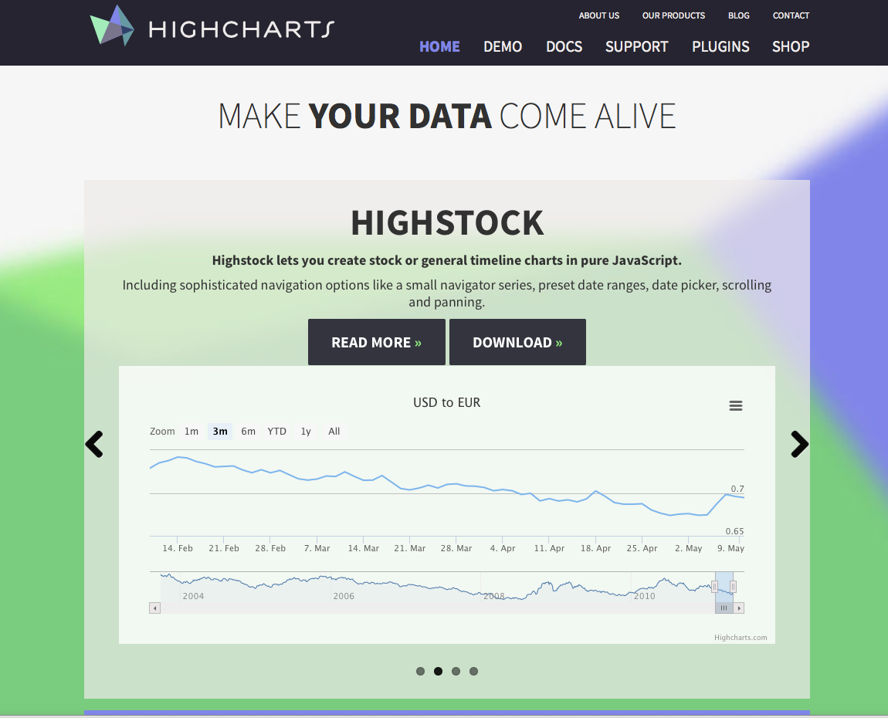
HighCharts goes OMNIS
Integration of a JavaScript based Chart system in OMNIS WebClient
http://www.highcharts.com

Slide 3
Objectives
WEB + Mobile
complex data-calculations in OMNIS !!
TimeLine,(like stock graphs/ HighStock)
Stacked Graphs
target version OMNIS 6.0-x
„handmade“ JSON Objects

Slide 4
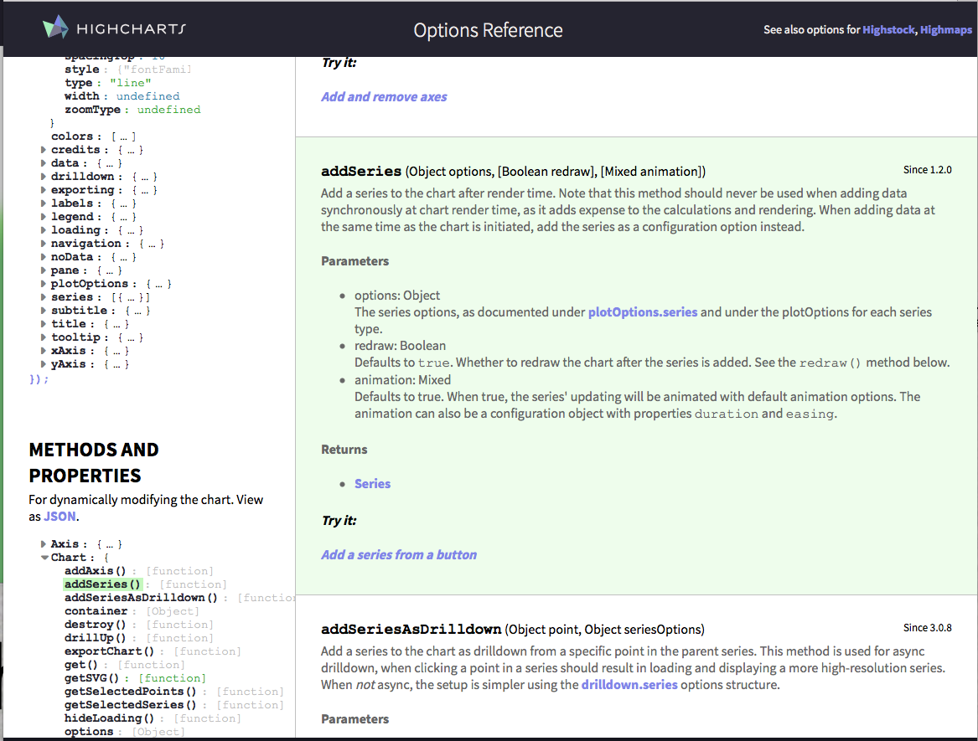
Great API
bunch of examples and JSFiddle

Slide 5
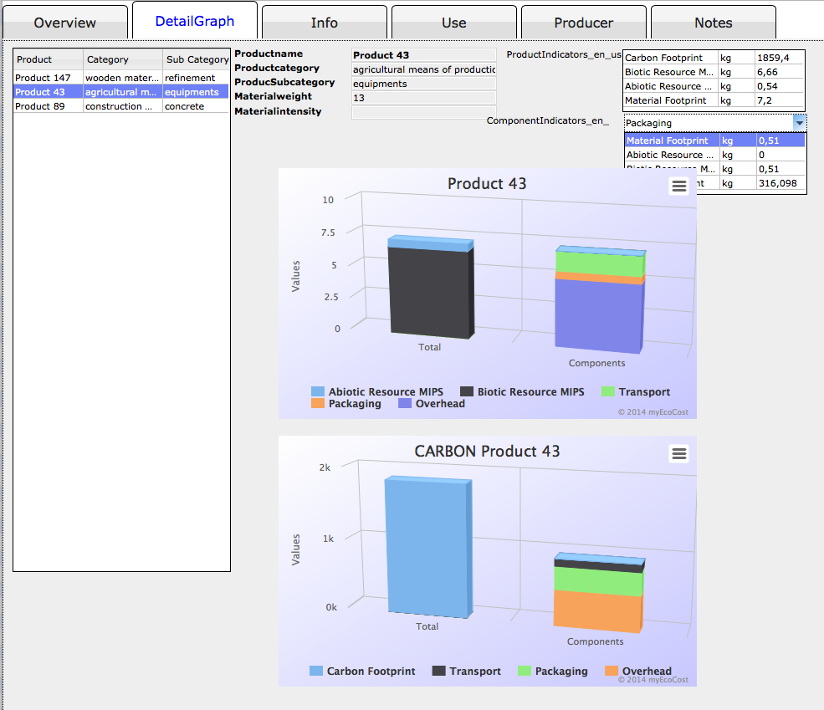
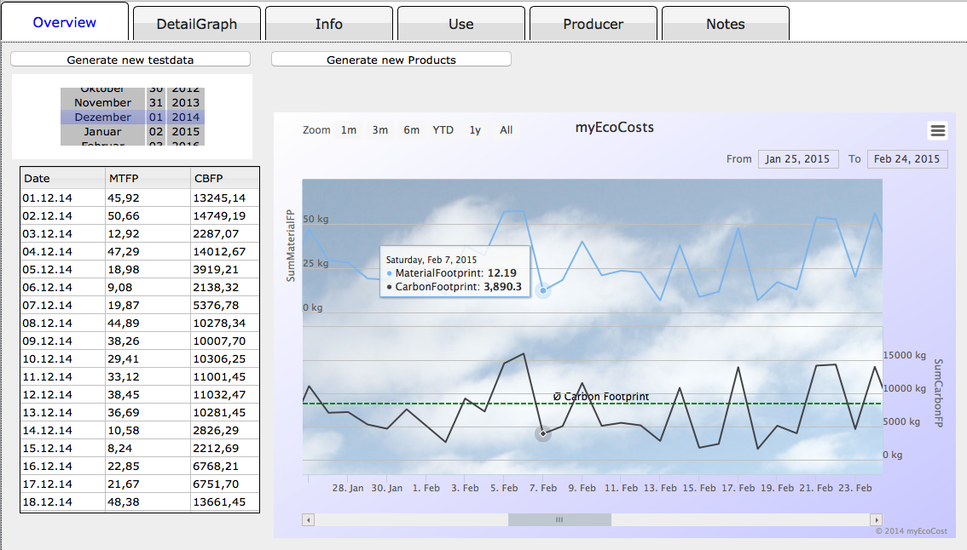
Example of WEB - GUI
Click
Drilldown

Slide 6
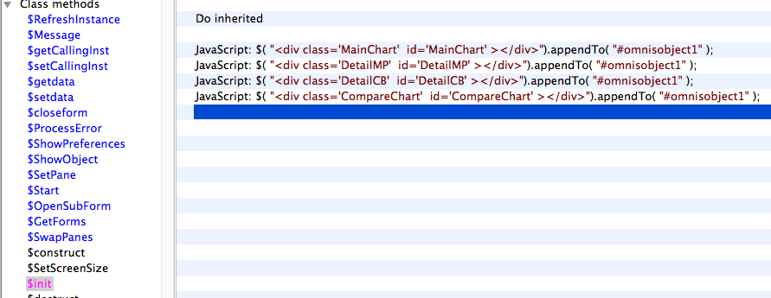
Placing of Graph Objects
HTML- body
omnisobject
GraphObject
$init : after OMNIS !!!! allen anderen

Slide 7
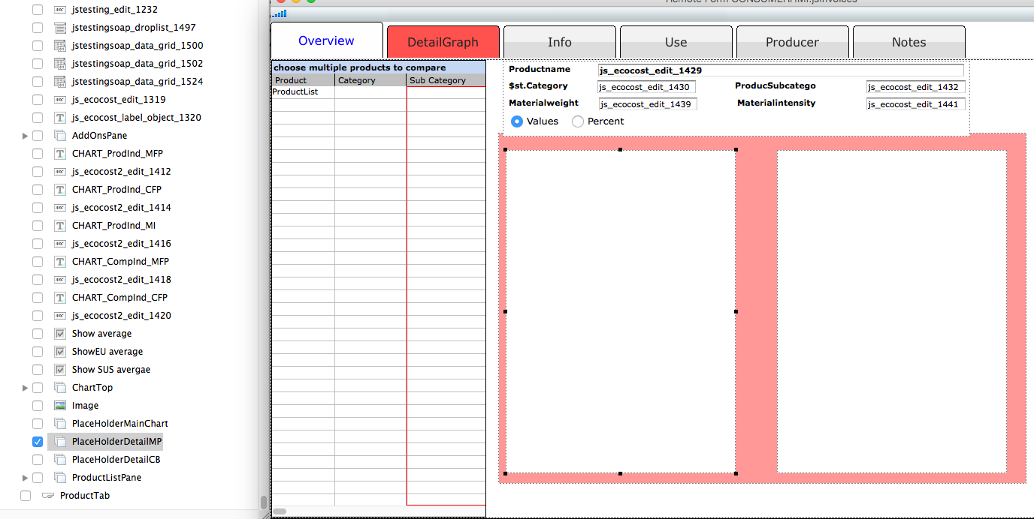
Omnis PlaceHolders / ScreenSize

Slide 8
Prepare Chart Options
Better using OMNIS JSON - object of 6.1
row/list —> JSON
mit JSON - object

Slide 9
Workflow
set boundings forChart Objects
prepare JSON’s for X and Y
„feed“ Chart Object with data“
start / show Chart Object

Slide 10
Client/Server communikation
Chart sends event to OMNIS : DataPoint: get Date
Call server to fetch the data
Only one Call !!!
async return from server delivering the results
Black = Execute on Server
Pink = Execute on Client

Slide 11
Tips
Never copy $EOC -methods, Bug (?!)
copy OMNIS Var’s in JS Var’s in „hybryd“ methods
„JavaScript: content = Liste.lstData;“ VERY HANDY !
use JSON objects in OMNIS >= 6.1
JAVASCRIPT- + OMNIScode have to be absolutely syntactical clean !!
don’f forget : „;“ , END IF …..
otherwise you are running in trouble getting strange JS errors

